Slide 1
Linear Algebra

Slide 2
The Determinant of a Matrix
For square matrices A there is a number called the determinant of A.
Determinant is used to know whether the matrix can be inverted or not, it is useful in analysis and solution of simultaneous linear equations (Cramer’s rule), used in calculus, used to find area of triangles (if coordinates are given) and more.

Slide 3
The determinant is denoted by det(A) or sometimes |A|.
It can be postive or negative.
Note that non-square matrices do not have determinants.
If a square matrix has determinant equal to zero, then it is called a singular matrix.

Slide 4
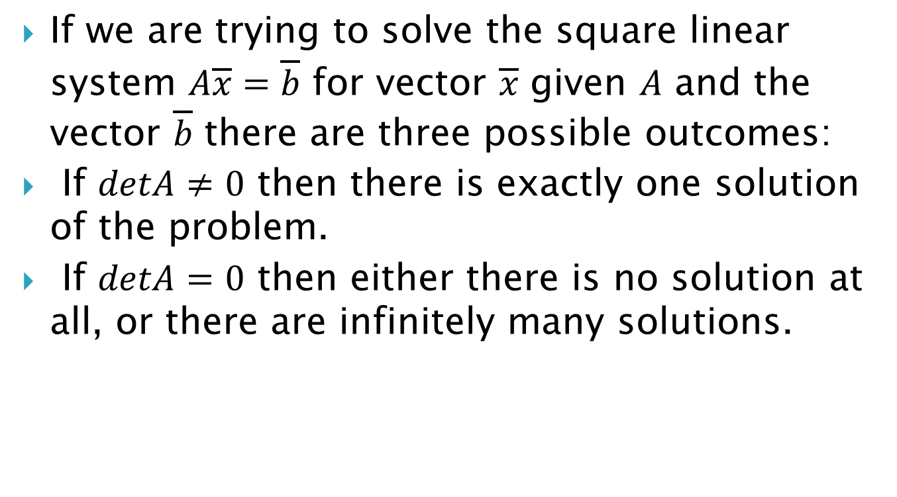
If we are trying to solve the square linear system $A\overline{x}=\overline{b}$ for vector $\overline{x}$ given $A$ and the vector $\overline{b}$ there are three possible outcomes:
If $detA≠0$ then there is exactly one solution of the problem.
If $detA=0$ then either there is no solution at all, or there are infinitely many solutions.

Slide 5
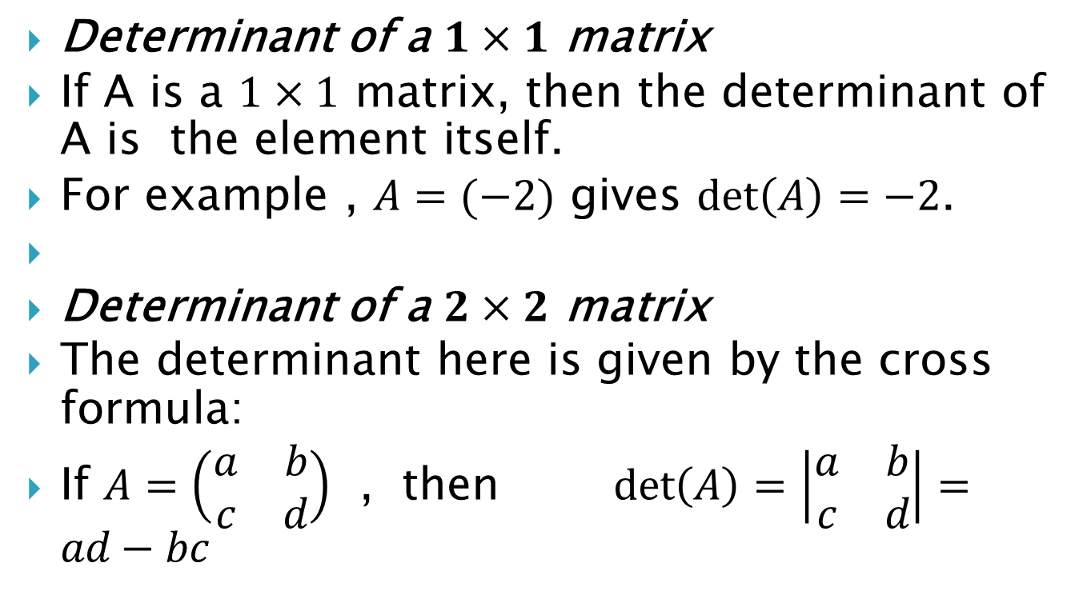
Determinant of a $1×1$ matrix
If A is a $1×1$ matrix, then the determinant of A is the element itself.
For example , $A=(−2)$ gives $\det\left(A\right)=−2$.
Determinant of a $2×2$ matrix
The determinant here is given by the cross formula:
If $A=\left(\begin{matrix}a & b \\ c & d\end{matrix}\right)$ , then $\det\left(A\right)=\left|\begin{matrix}a & b \\ c & d\end{matrix}\right|=ad−bc$

Slide 6

Example 1 . $A=\left(\begin{matrix}1 & 2 \\ 3 & 4\end{matrix}\right)$ , then
$\det\left(A\right)=\left|\begin{matrix}1 & 2 \\ 3 & 4\end{matrix}\right|=1×4−2×3=−2.$

Slide 7
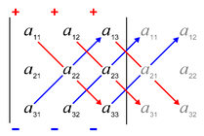
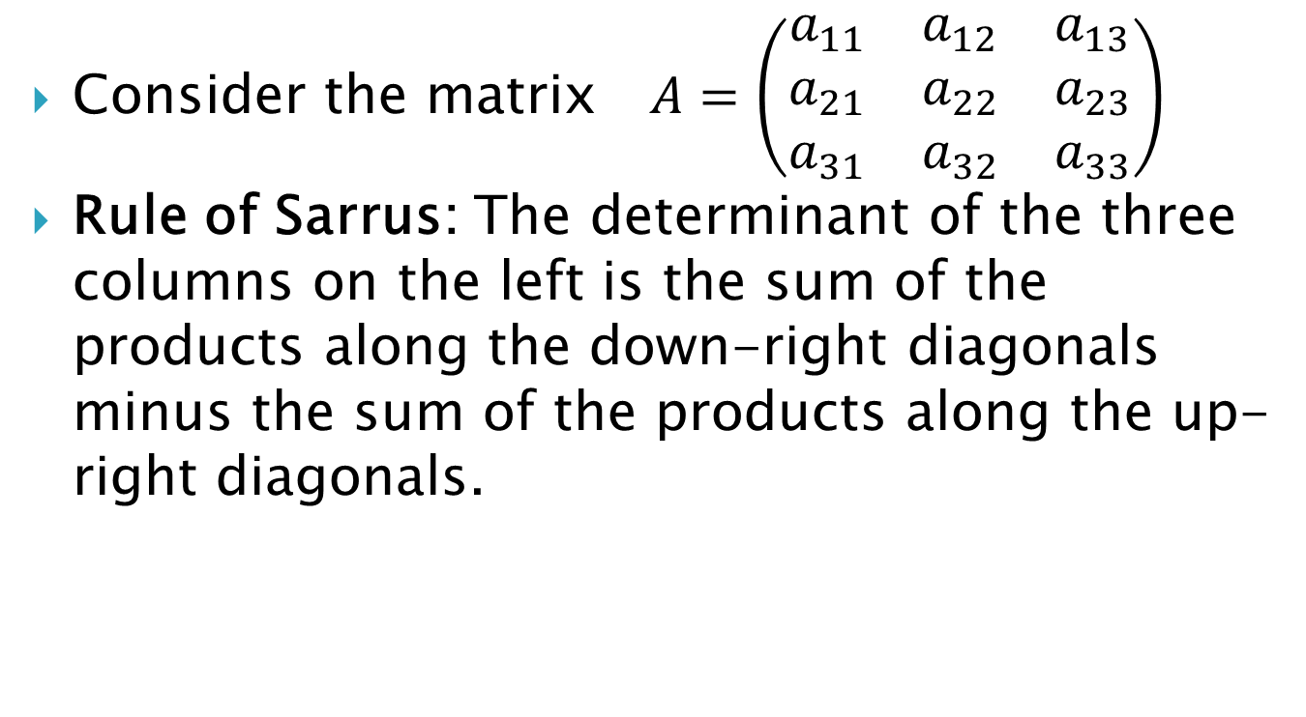
Determinant of a 3 × 3 matrix
Consider the matrix $A=\left(\begin{matrix}a_{11} & a_{12} & a_{13} \\ a_{21} & a_{22} & a_{23} \\ a_{31} & a_{32} & a_{33}\end{matrix}\right)$
Rule of Sarrus: The determinant of the three columns on the left is the sum of the products along the down-right diagonals minus the sum of the products along the up-right diagonals.

Slide 8
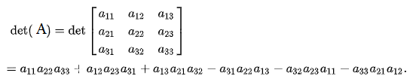
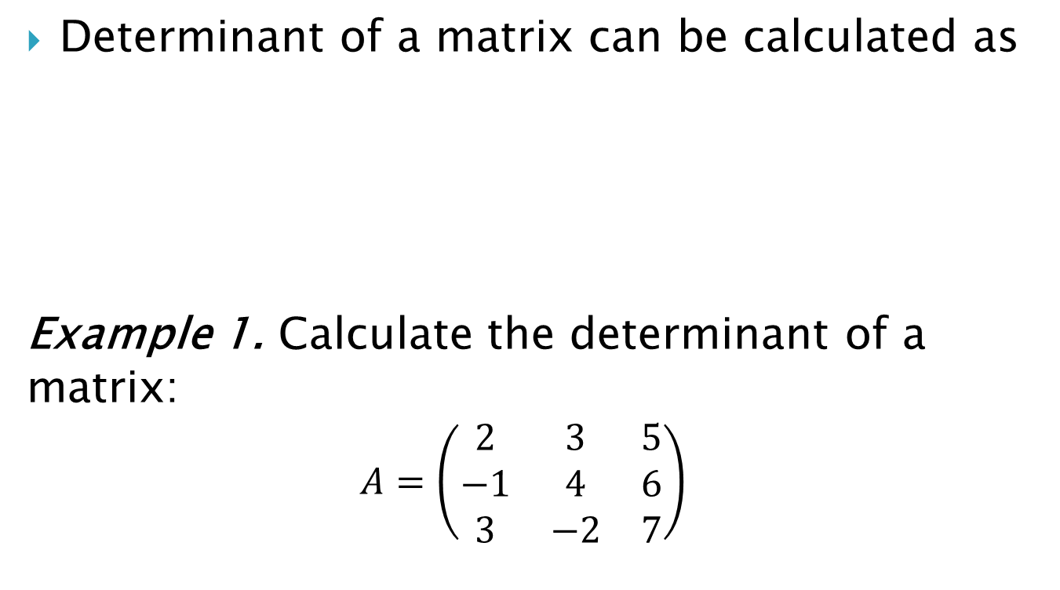
Determinant of a matrix can be calculated as
Example 1. Calculate the determinant of a matrix:
$$A=\left(\begin{matrix}2 & 3 & 5 \\ −1 & 4 & 6 \\ 3 & −2 & 7\end{matrix}\right)$$

Slide 9

Example 2. Evaluate the determinant
$a) \left|\begin{matrix}5 & 3 & 3 \\ −4 & −5 & 1 \\ 5 & 3 & 0\end{matrix}\right|$
$b) \left|\begin{matrix}−6 & −6 & 1 \\ 3 & −5 & −2 \\ 4 & 3 & −3\end{matrix}\right|$

Slide 10
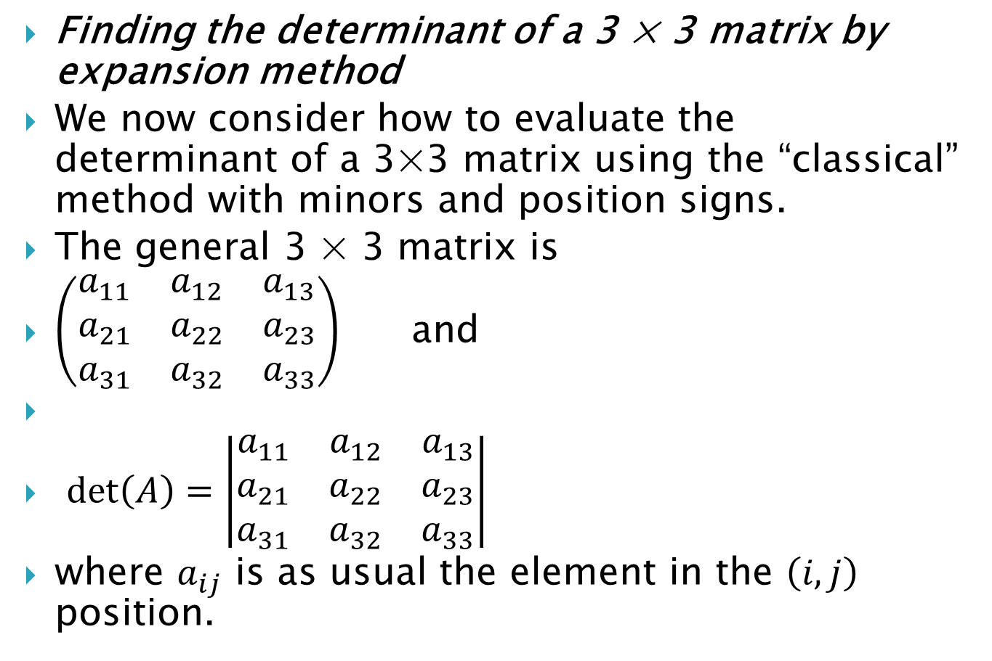
Finding the determinant of a 3 × 3 matrix by expansion method
We now consider how to evaluate the determinant of a 3×3 matrix using the “classical” method with minors and position signs.
The general 3 × 3 matrix is
$\left(\begin{matrix}a_{11} & a_{12} & a_{13} \\ a_{21} & a_{22} & a_{23} \\ a_{31} & a_{32} & a_{33}\end{matrix}\right)$ and
$\det\left(A\right)=\left|\begin{matrix}a_{11} & a_{12} & a_{13} \\ a_{21} & a_{22} & a_{23} \\ a_{31} & a_{32} & a_{33}\end{matrix}\right|$
where $a_{ij}$ is as usual the element in the $\left(i,j\right)$ position.

Slide 11
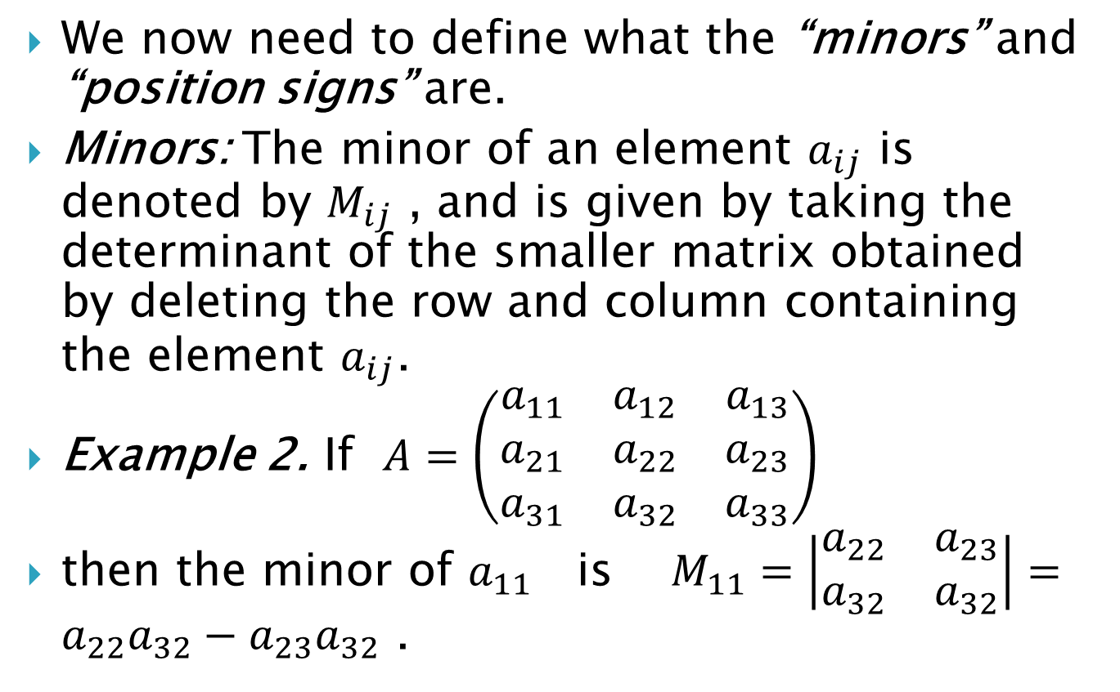
We now need to define what the “minors” and “position signs” are.
Minors: The minor of an element $a_{ij}$ is denoted by $M_{ij}$ , and is given by taking the determinant of the smaller matrix obtained by deleting the row and column containing the element $a_{ij}$.
Example 2. If $A=\left(\begin{matrix}a_{11} & a_{12} & a_{13} \\ a_{21} & a_{22} & a_{23} \\ a_{31} & a_{32} & a_{33}\end{matrix}\right)$
then the minor of $a_{11}$ is $M_{11}=\left|\begin{matrix}a_{22} & a_{23} \\ a_{32} & a_{32}\end{matrix}\right|=a_{22}a_{32}−a_{23}a_{32}$ .

Slide 12
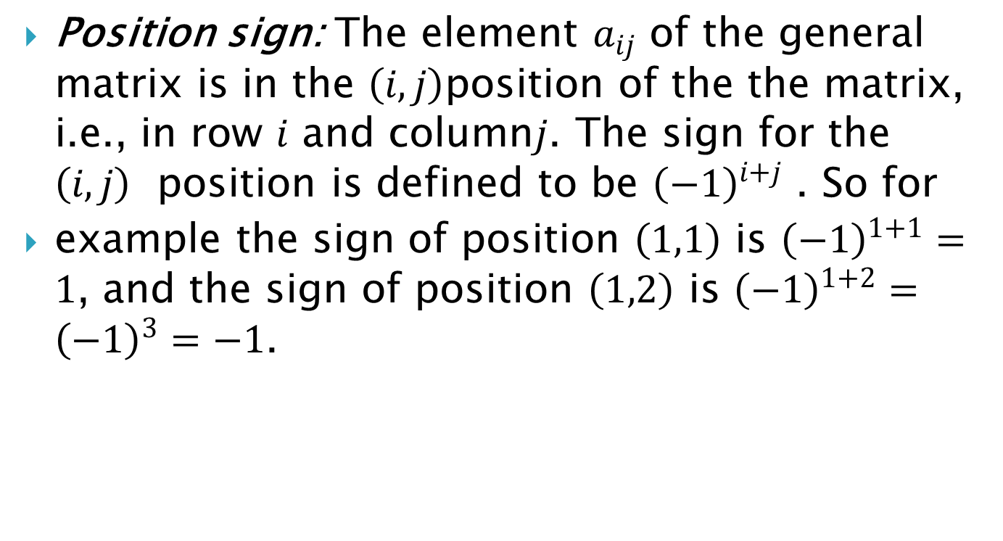
Position sign: The element $a_{ij}$ of the general matrix is in the $\left(i,j\right)$position of the the matrix, i.e., in row $i$ and column$j$. The sign for the $\left(i,j\right)$ position is defined to be ${\left(−1\right)}^{i+j}$ . So for
example the sign of position $\left(1,1\right)$ is ${\left(−1\right)}^{1+1}=1$, and the sign of position $\left(1,2\right)$ is ${\left(−1\right)}^{1+2}={\left(−1\right)}^{3}=−1$.

Slide 13
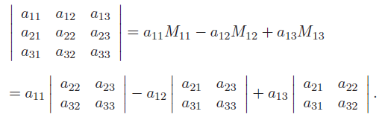
We use the minors and position sign to get
We say that the determinant has been expanded along the first row. We can expand the determinant along any row or column.

Slide 14
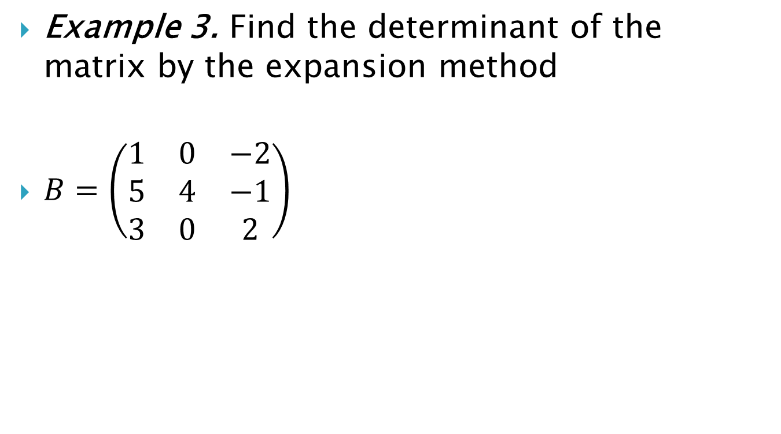
Example 3. Find the determinant of the matrix by the expansion method
$B=\left(\begin{matrix}1 & 0 & −2 \\ 5 & 4 & −1 \\ 3 & 0 & 2\end{matrix}\right)$

